Slide 1
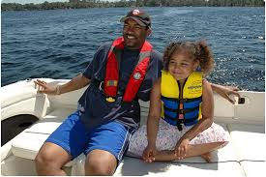
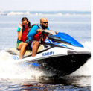
Life Jacket Labeling
New
2 Mar 2021

Slide 2
Consider
79% of Boating Deaths due to Drowning
86% were not wearing Life Jackets
66% were good swimmers

Slide 3
Learning Objectives
Understand New Life Jacket Labels
Compare to Legacy Labels and Designation
Review Life Jacket & PFD Requirements

Slide 4
Grandfather Clause
No need to buy new life jackets
Type I, II, III, IV and V PFD’s can remain in service until they need to be replaced.
Manufacturers continue to use old labels until models are changed

Slide 5
Why New Labels?
Most boaters do not understand the legacy Type designation
Who should wear what Type
What Type is used for what activities
Limitations of the device
Maintenance
Compatibility with International Boaters
especially Canada

Slide 6
New Standards
Much more information on label
Based on International Test Methods
For commercial as well as recreational boating
Relies upon third party verification
Still “Approved” by USCG

Slide 7
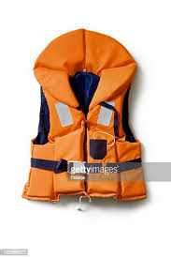
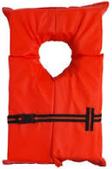
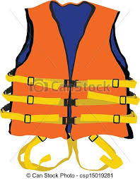
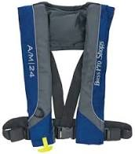
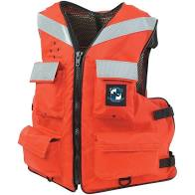
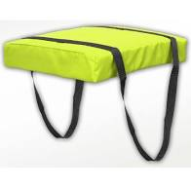
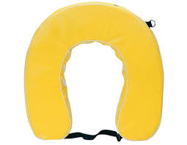
2 Types
Wearable
Throwable

Slide 8
No Change in Requirements
One wearable jacket for each person on board
Appropriate Size & Activity
USCG Approved
Serviceable condition & Accessible
One throwable on vessels over 16’
Serviceable Condition
Accessible
USCG Approved

Slide 9
Exceptions
Throwable not required on canoes or kayaks over 16’
Wearables not required on sailboards or racing paddle craft
A wearable does not meet requirements for a throwable
Check Label

Slide 10
Inflatables
16 years or older
Depending on label, may or may not have to be worn to count towards “one life jacket per wearer” requirement (check label)
Not intended for jet skis, white water, towed activities
Must be serviceable

Slide 11
Children (under 13 years)
Must wear appropriate life jacket
In “Federal” Waters
Unless
below decks
In cabin
When anchored, aground or tied up at dock
Most tidal boating areas in Virginia are Federal Waters

Slide 12
Accessible
Wearable – “readily accessible”
Out in the open or stowed were easy to reach
Not in protective coverings or under lock and key or under other equipment
Throwable – “immediately available”
Out in the open, not in protective cover, closed compartment or under other equipment
No requirement for attached line

Slide 13
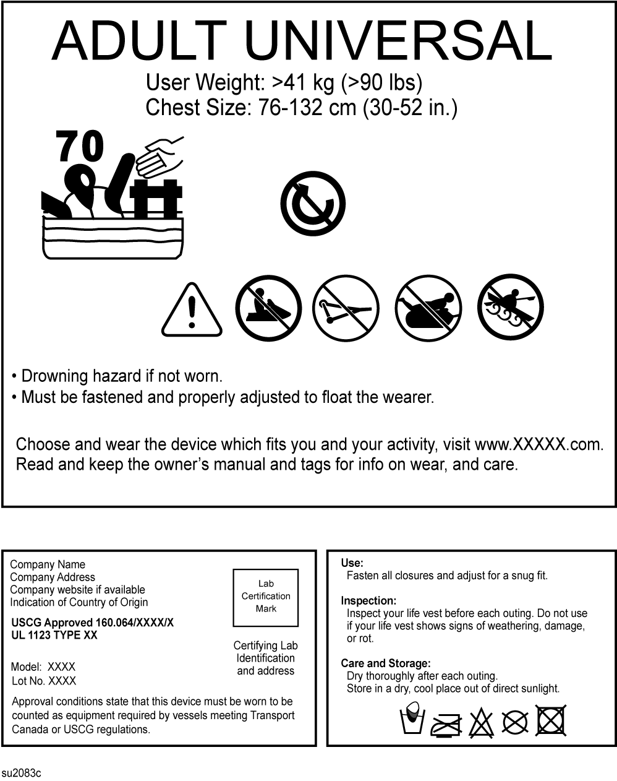
New Label – Part 1

Slide 14
New Label – Part 2
Plus User Manual when purchased

Slide 15
Intended Wearers
Intended Wearers
Adult > 90 lb.
Youth > 50 lb
Child > 33 lb
Infant < 33 lb

Slide 16
Size

Slide 17
Buoyancy
Buoyancy
in Newtons
70 N ~ 15.5 lb.

Slide 18
Boating Environment

Slide 19
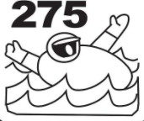
Boating Environment
Offshore
Extreme Conditions
Extra weight
tools/clothes
Type I
(should turn wearer)

Slide 20
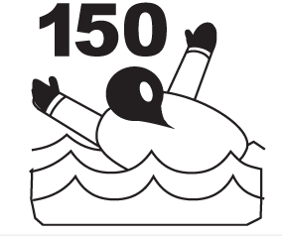
Boating Environment
General use with foul weather gear
Extended immersion
Type I
(should turn wearer)

Slide 21
Boating Environment
Sheltered Waters
Not Rough Waters
Some wait for rescue
Type II
Type III if fails to turn wearer

Slide 22
Boating Environment
Sheltered Waters
Close to Shore
Competent Swimmer
Rescue Close at Hand
Type II
Type III if fails to turn wearer

Slide 23
Boating Environment
Not for Adults
Children & Youth < 90 lb
Rescue Close at Hand
Competent Swimmers
Type II
Type III if fails to turn wearer

Slide 24
Comparison
For adults wearing inherent flotation
Type | Minimum Buoyancy |  | Turning Ability
 | Lb. | N
I | 22 | 100 | Yes
II | 15.5 | 70 | Yes
III | 15.5 | 70 | No
V | 15.5 | 70 | Yes or No

Slide 25
Turning Ability

Slide 26
Turning Ability
Turns most wearers face up
Will not turn most wearers face up

Slide 27
New Limitations of Use
Limitations

Slide 28
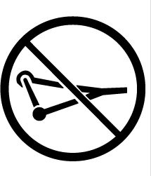
Limitations
No PWC
No Skiing
No Tubing
No White-water
Warnings

Slide 29
USCG Approval

Slide 30
Usage Instructions

Slide 31
Care, Storage, Maintenance
Discussed in User Manual

Slide 32
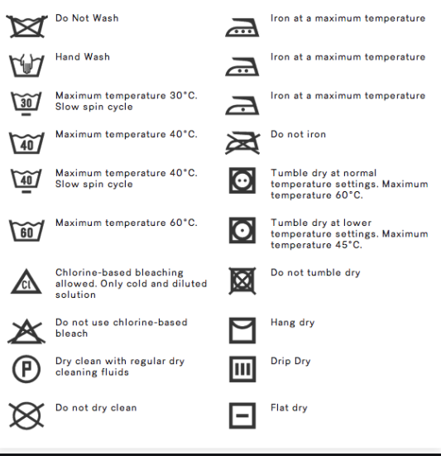
International Care Symbols

Slide 33
International Care Symbols

Slide 34
Accessible
Wearable – “readily accessible”
Out in the open or stowed were easy to reach
Not in protective coverings or under lock and key
Throwable – “immediately available”
Not in protective cover, closed compartment or under other equipment
No requirement for attached line

Slide 35
Serviceable
“No deterioration affecting performance”
No broke, corroded or deformed hardware
Webbing and straps secured
No rips, tears, rot or open seams
Flotation no degraded

Slide 36
Serviceable
Inflatables
in addition to above
Armed inflation mechanism
Full cartridge and status indicator
Air chamber hold air
Oral inflation tube functional
Inflation lanyard or trigger functional

Slide 37
Summary
New labels appearing in stores
Slowly
Old “Type” devices are okay to use while they are serviceable
New labels provide more information on wearer, use, limitations and care

Slide 38
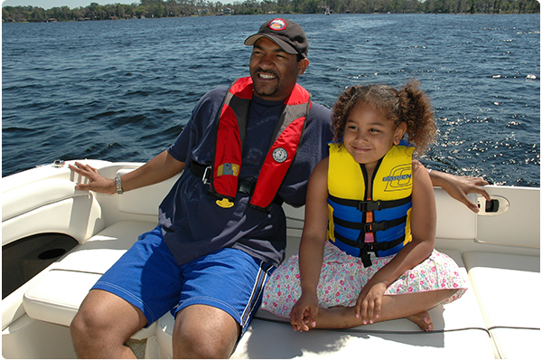
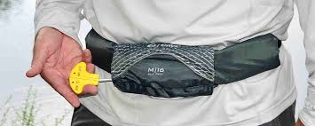
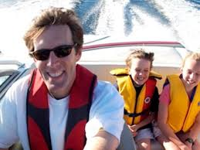
Many Comfortable Styles

Slide 39
Take the Pledge
I will always wear my life jacket while boating or fishing and encourage others to do the same!
I’ll regularly inspect my life jacket and keep it in good condition.
I pledge to boat safely and responsibly – and to have fun!

